Slide 1






SOCCER LEAGUE
DATABASE
Design and Implementation
Alisson Inacio

Slide 2

INTRODUCTION
This project was based in regular soccer league from Brazil: Brasileirao. All code was made in MySQL and applied the basic principles learned in the course ITM 220.

Slide 3
REQUIREMENTS
Design and build the blueprint for a database, an ERD
Forward Engineer a design by using MySQL Workbench
Build at least twelve database tables.
Develop use-cases to verify the design and data structures.
Write quality assurance test scripts to verify your project.

Slide 4




ENTITIES
Teams
Players
Coaches
Matches
Seasons
Stadiums
Leagues
Sponsors
Positions
Performance statistics
Injuries
Contracts

Slide 5




ATTRIBUTES
Seasons: season_id (PK), year
Stadiums: stadium_id (PK), name, capacity, city
Leagues: league_id (PK), name, country
Sponsors: sponsor_id (PK), name, industry
Teams: team_id (PK), name, city, stadium_id (FK)
Players: player_id (PK), name, birth_date, team_id (FK), position_id (FK), nationality
Coaches: coach_id (PK), name, team_id (FK)
Matches: match_id (PK), date, home_team_id (FK), away_team_id (FK), stadium_id (FK), season_id (FK)
Positions: position_id (PK), name
Performance Statistics: stat_id (PK), player_id (FK), match_id (FK), goals, assists, minutes_played
Injuries: injury_id (PK), player_id (FK), description, start_date, end_date
Contracts: contract_id (PK), player_id (FK), team_id (FK), start_date, end_date, salary

Slide 6

RELATIONSHIP AND ERD
One-to-many: One team has many players, one league has many teams, etc.
Many-to-many: Players can have multiple injuries, teams can have multiple sponsors, etc.

Slide 7
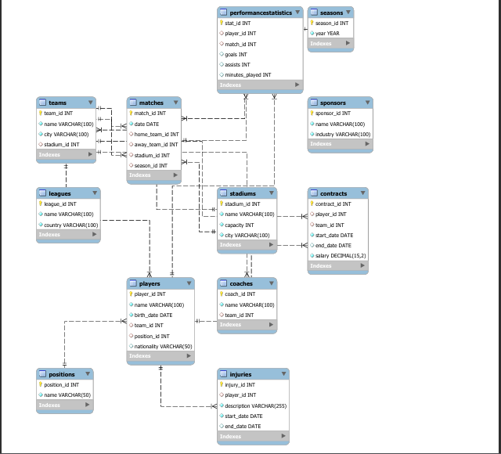
ERD DIAGRAM

Slide 8
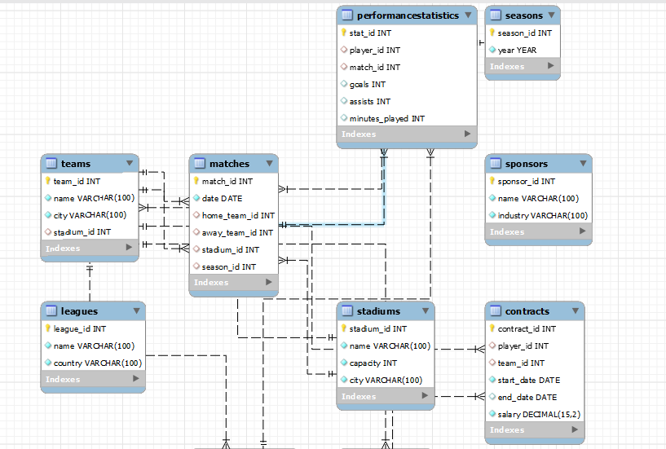
DETAIL - 1

Slide 9
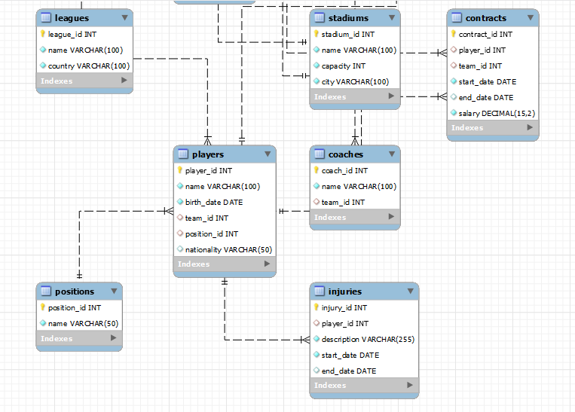
DETAIL - 2

Slide 10

GENERAL SCRIPTS
The SQL scripts provided are a series of statements used to create, populate, and manage a soccer league database. They begin with the creation of the database and tables, ensuring each table is structured correctly with necessary fields and foreign key constraints. Following this, there are scripts for inserting sample data into each table, facilitating initial testing and validation. The scripts cover all CRUD operations (Create, Read, Update, Delete) for each of the 12 tables, demonstrating how to manage records effectively. Each script is tailored to handle the specifics of each table, ensuring data integrity and proper relational mappings.

Slide 11
DEVELOP CRUD TEST CASES
Create: Test case for adding a new player.
Read: Test case for retrieving match schedules.
Update: Test case for updating a player's injury status.
Delete: Test case for removing a retired player's record.

Slide 12
CRUD OPERATIONS
CRUD operations form the backbone of database management, enabling users to Create, Read, Update, and Delete records within the database. In this project, each table has dedicated CRUD scripts to illustrate these operations. For instance, the INSERT statements add new records to tables like Teams, Players, and Coaches, while SELECT statements retrieve and display the data. UPDATE statements modify existing records, such as changing a player's nationality, and DELETE statements remove records from the database. These operations are crucial for maintaining up-to-date and accurate data within the soccer league management system.

Slide 13


QUALITY ASSURANCE TESTS
Quality assurance (QA) test scripts are essential for validating the functionality and reliability of the database operations. The provided QA test scripts encompass the full range of CRUD operations for each table, ensuring that every aspect of data management is thoroughly tested. These scripts include INSERT statements to create records, SELECT statements to verify the data, UPDATE statements to ensure data can be modified correctly, and DELETE statements to confirm records can be removed without issues. By running these scripts, one can verify that the database operates as expected, with all relational constraints and data integrity preserved.

Slide 14


UI FORMS, SHOW CASE AND MOCK-UPS

Slide 15
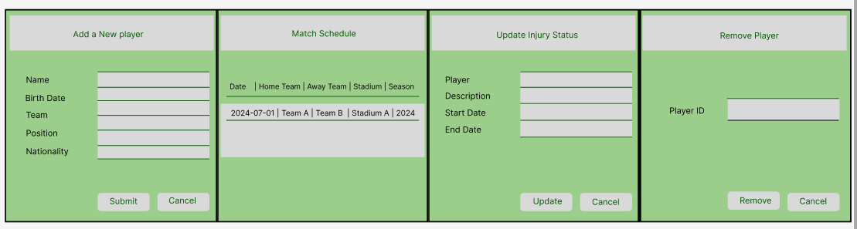
MOCK-UP 1

Slide 16
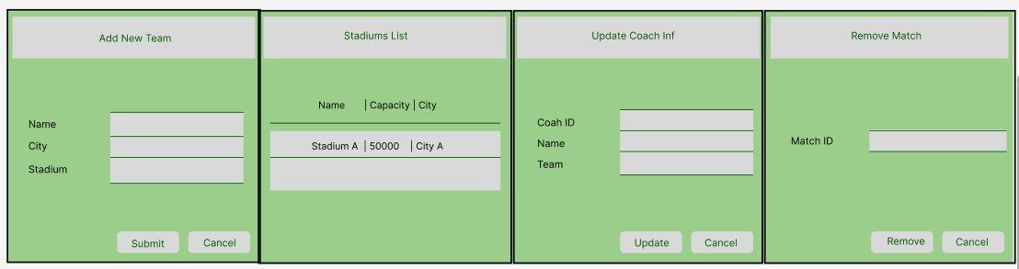
MOCK-UP 2

Slide 17
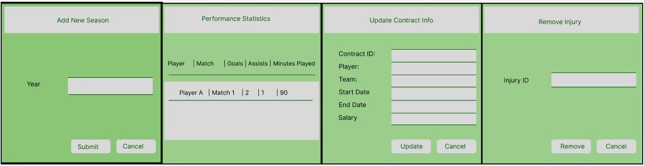
MOCK-UP 3

Slide 18

KEY ACHIEVEMENTS
Comprehensive Database Implementation:
Mastery of CRUD Operations
Rigorous Quality Assurance
Successfully created a soccer league management system with well-defined tables for teams, players, coaches, matches, seasons, stadiums, leagues, sponsors, positions, performance statistics, injuries, and contracts, ensuring a fully normalized and relationally consistent database.
Demonstrated proficiency in SQL by writing and executing scripts for creating, reading, updating, and deleting records across all 12 tables, ensuring data accuracy and integrity through practical application of database management principles.
Developed and executed detailed quality assurance test scripts to validate the correctness and reliability of database operations, ensuring robust functionality and adherence to design specifications.

Slide 19
THANKS!!!

